Slide 1
The Summarizer

Slide 2
Members :-
Yash Roop Rai
Ritesh Pahal
Kartik

Slide 3
Overview
An app to provide you important information from chunk of text you give it.
The best part about this app ,it’s lightweight and usable on any device.

Slide 4
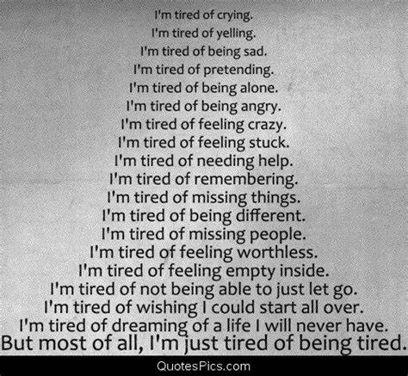
Do long texts bore you?
Have you ever had to read long reports and articles when you’re surrounded by deadlines?
Do you often miss crucial details while reading a long paragraph?

Slide 5
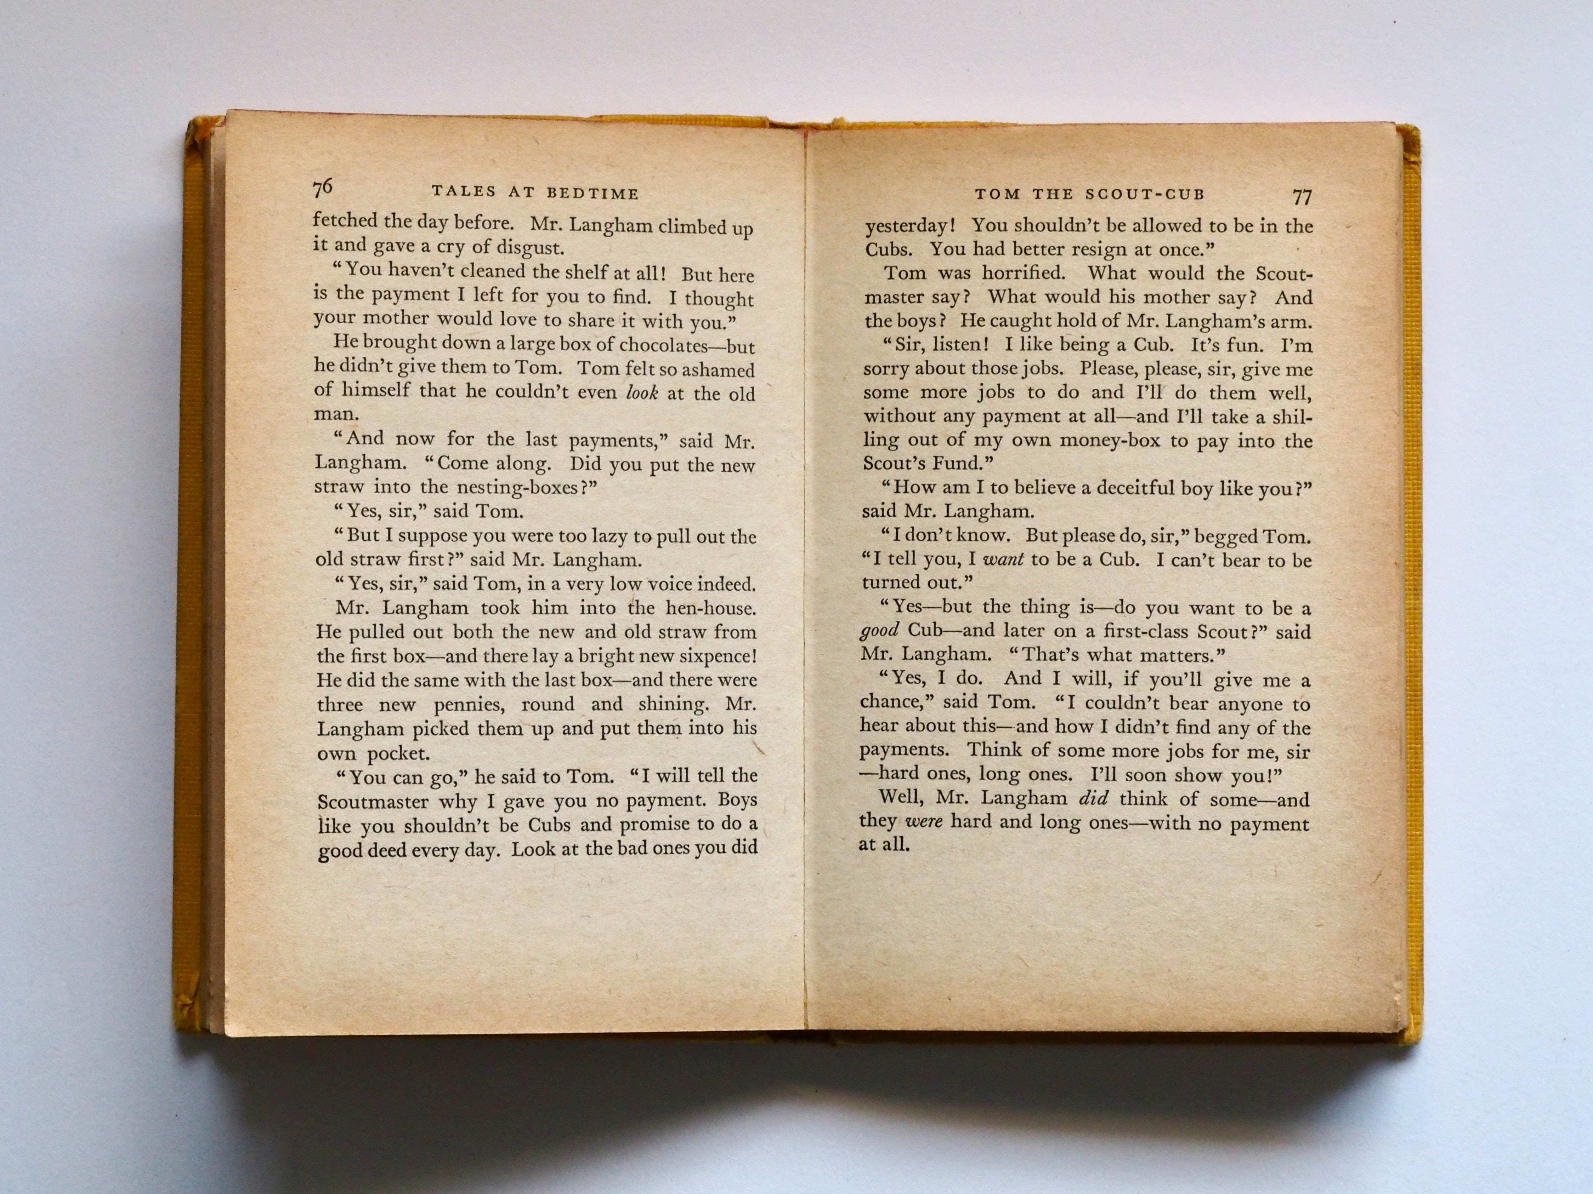
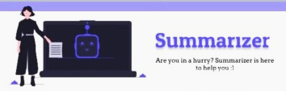
The summarizer is what you need.

Slide 6
The summarizer is an app that converts all your text into a short summary, this is the age of technology, so why not use it’s capabilities efficiently, just install this app on your device and get shorter content right away, anywhere with the click of a button!

Slide 7
To give some tech details for the nerds ,this app is written in Kotlin and Python ,which enabled us to write lightweight code that can process anything on the go on any device.
How to use this app is pretty simple and can be shown in the next few slides

Slide 8
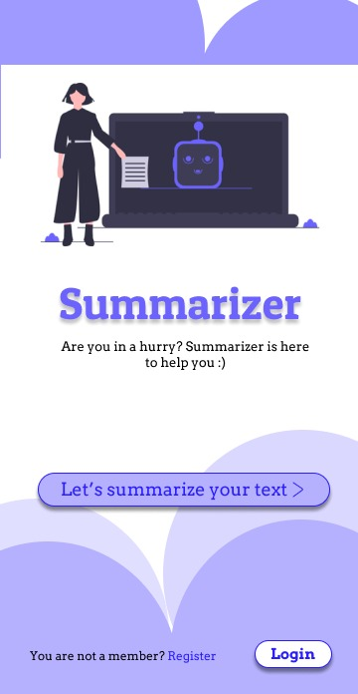
Front end
A simple and user friendly user interface, that is easy to navigate and use.

Slide 9
Click on this button to get started with the summarizer
Log in to the application to save your summaries for later use ,or sharing across platforms

Slide 10
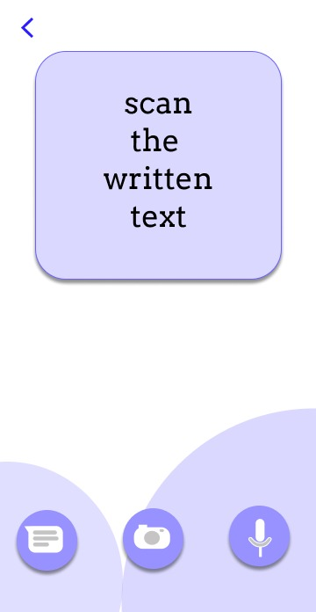
If you are reading the text just press on the microphone icon and start speaking , press again when you are done
Or if you have image of the said text , need not to worry , just upload that picture by clicking the camera icon.
Copy the text directly into input.

Slide 11
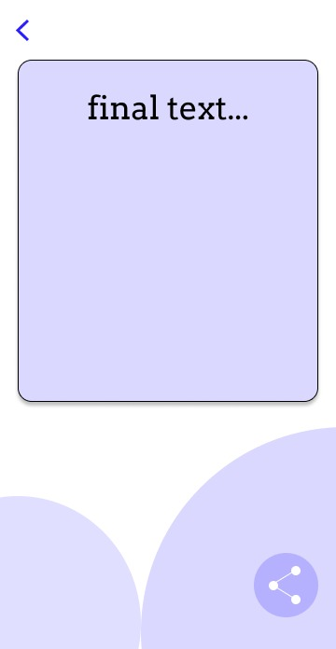
Get the text as a short summary consisting only the relevant information from the chunk of data you fed our application.
That’s all it is to use the summarizer ,go on about your work and let the summarizer worry about giving you only the important part of the text.
You can also share your summary with others ,such as your friends that writing an assignment ,project report ,or any article with you

Slide 12
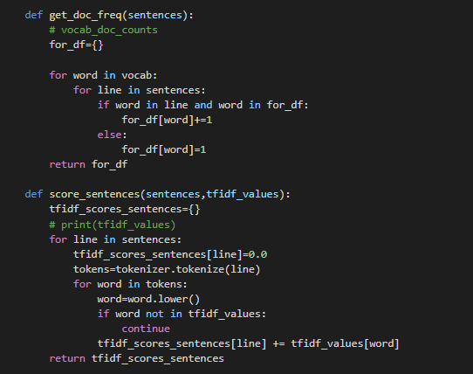
These are the functions that are being used to predict the relevancy of a snippet of text to the context of the document.
This is being done at the backend of the application and using python language.

Slide 13
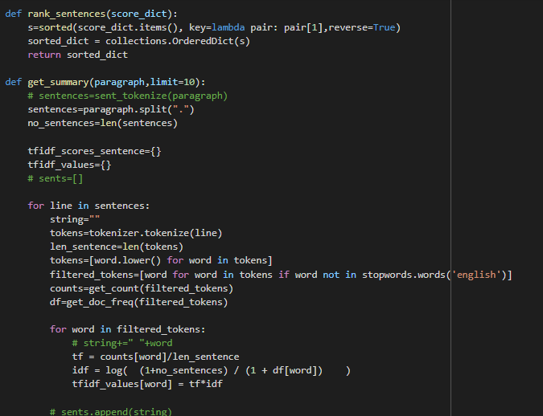
This is a snippet of the main function that is calling all the helper functions and then returns the summarized text which is shown to the user as the output in the app.

Slide 14
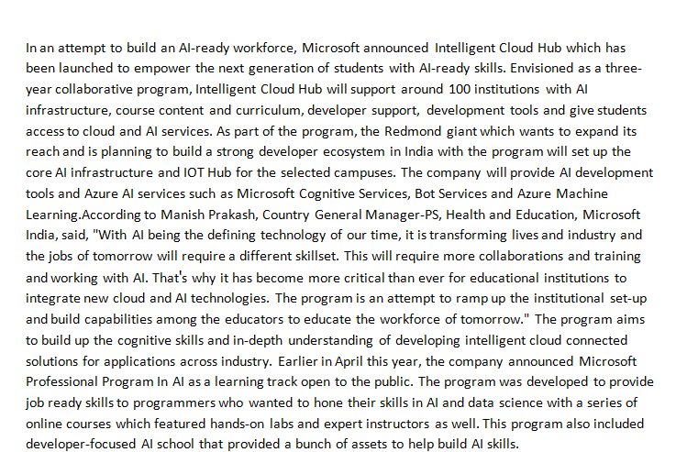
Input

Slide 15
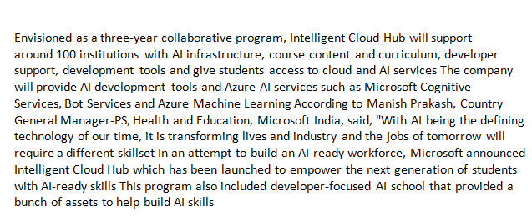
Output

Slide 16
THANK YOU

